Slide 1
Azure Databricks Overview And Subscription
Submitted By
Maimoona Khilji

Slide 2
Content
Introduction
Account Subscription
Azure Databricks
Introduction, Creation, Recent Changes to databricks UI, Architecture

Slide 3
Account Subscription

Slide 4
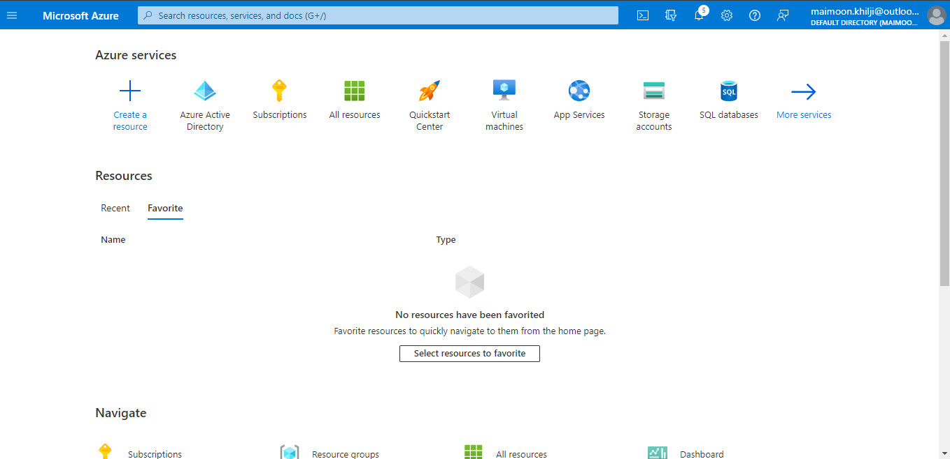
Azure Account Subscription

Slide 5
Azure Databricks

Slide 6
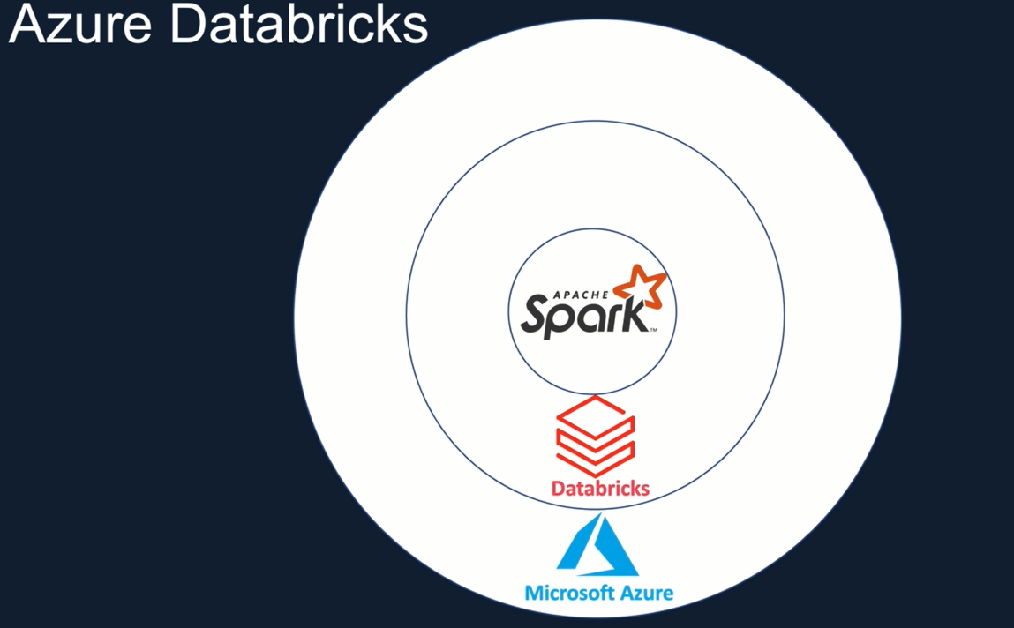
Azure Databricks

Slide 7
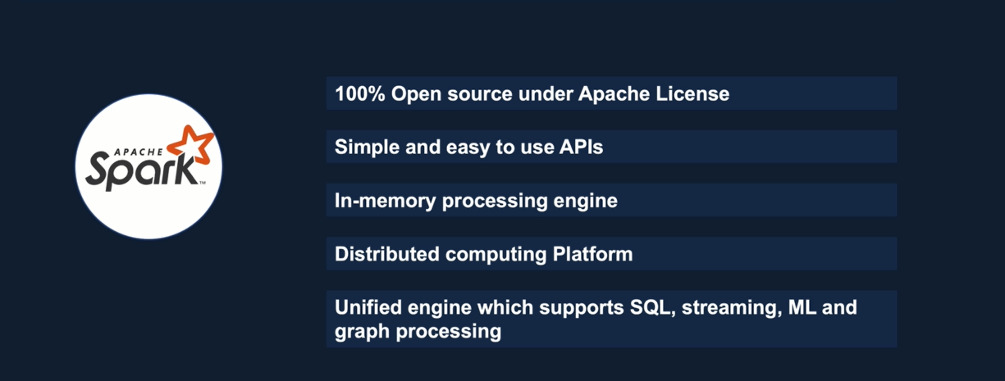
Apache Spark

Slide 8
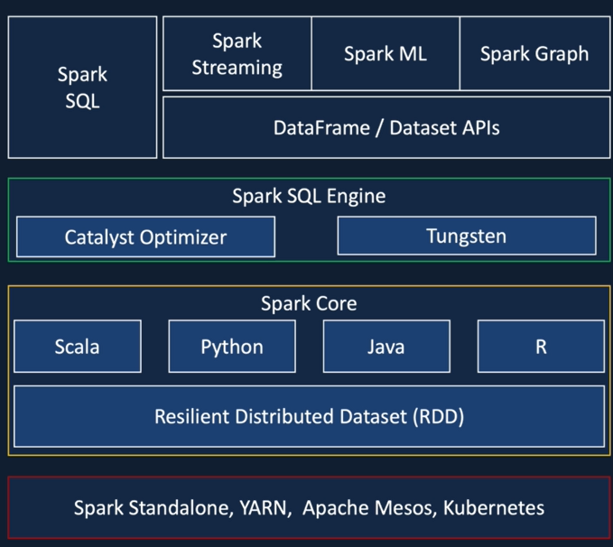
Spark Architecture

Slide 9
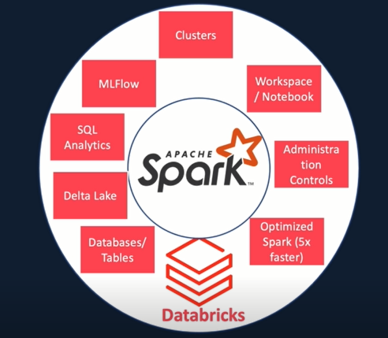
Databricks - Spark

Slide 10
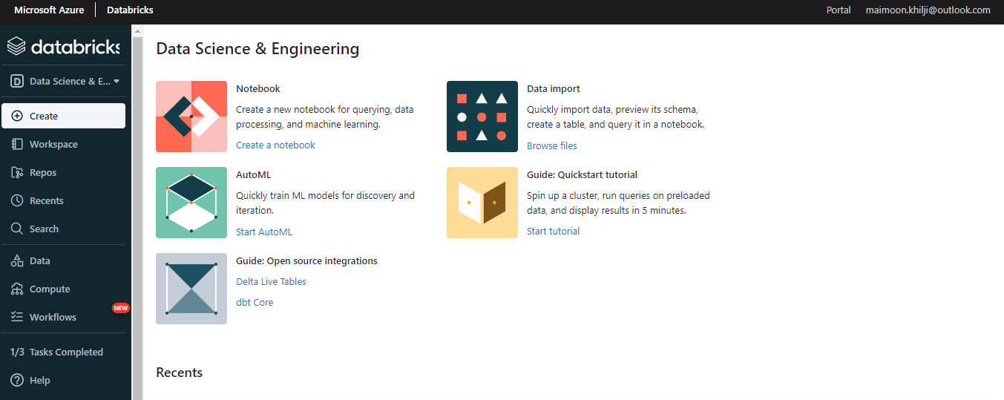
Create Azure Databricks Services

Slide 11
THE END

